Slide 1
Smart grid
- Piyush saxena

Slide 2
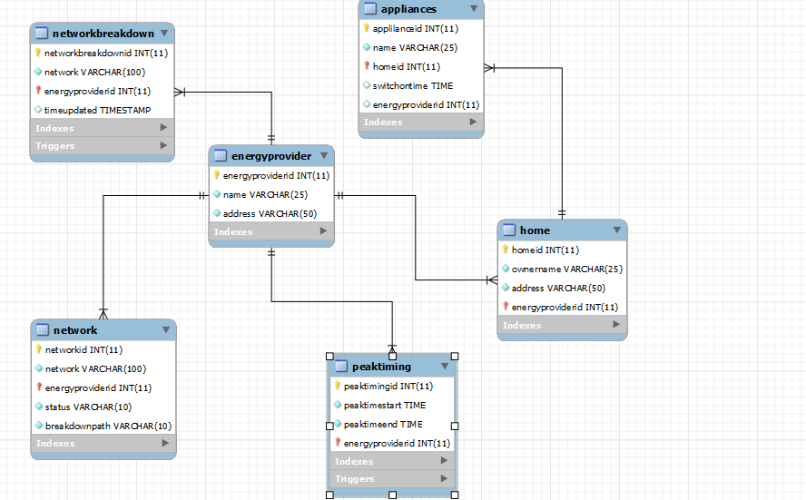
EER Diagram

Slide 3
About the project
A smart grid is a framework which automatically identifies the changes in a system like electricity supply system and makes changes in itself.
The following things have been implemented in my project.
The energy provider can identify the peak time and insert that in the PeakTiming table and all the appliances that are connected with the homes which are in the boundary of the energy provider will switch on after the peak time is over. This will reduce the probability of a shutdown due to over load.

Slide 4
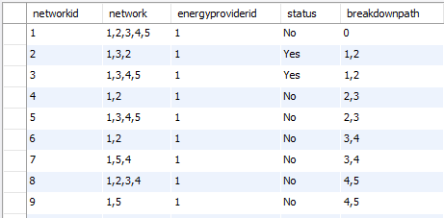
About the project
If a network between two homes is down because of a catastrophe then an alternate route is selected by the database.
1
5
2
4
3
When there is a breakdown between path 1 and 2. Then only two tuples which are marked as Yes under status where networked = ‘2’ and ‘3’.
If there is a breakdown between homes 1 and 2, then if we have a path of flow of electricity 1-3-4-5 and 1-3-2, then all homes will get electricity.
In my project I have automated this, if there is a breakdown for any of the paths 1,2 or 2,3 or 3,4 or 4,5; then status of the corresponding path will become Yes.

Slide 5
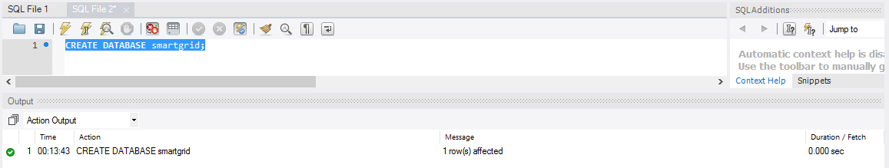
Set 1 – Create Database

Slide 6
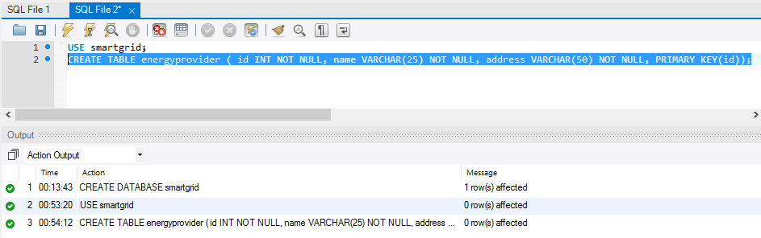
Set 1 – Create Tables and USE

Slide 7
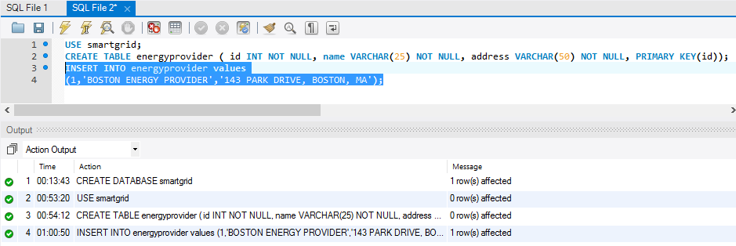
SET 1 – InSERT INTO

Slide 8
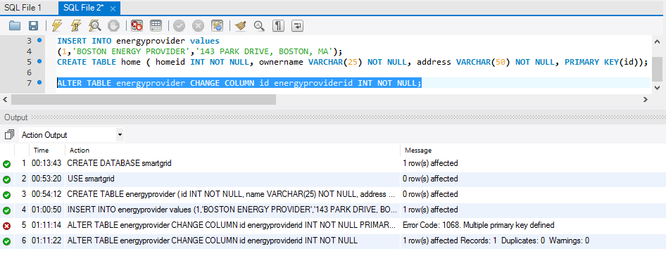
SET 1 – Alter Table

Slide 9
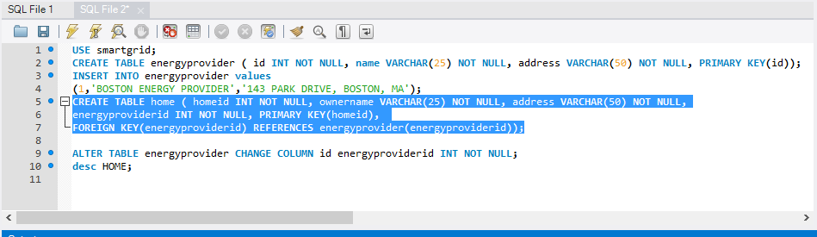
SET 2 – Create Table, Key, Datatypes, Index

Slide 10
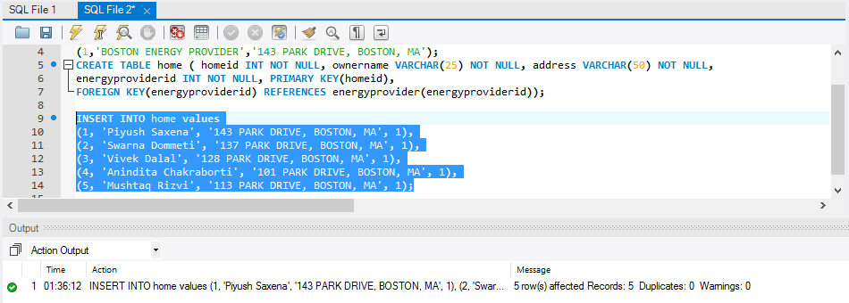
SET 2 – Insert Into

Slide 11
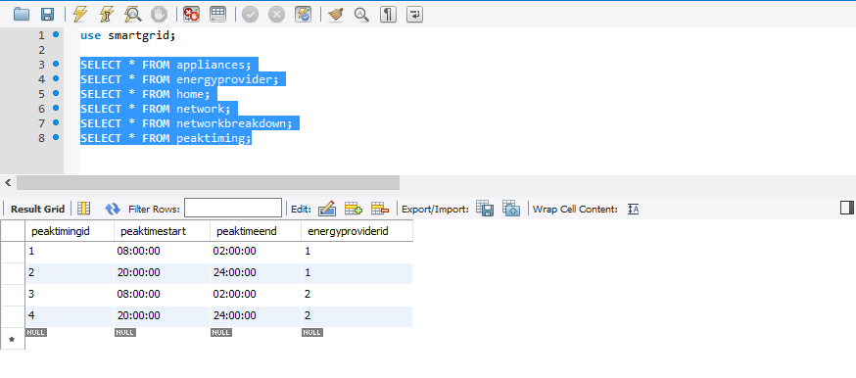
Set 3 - Select – From – Where – Group By – Having - Order By - Limit

Slide 12
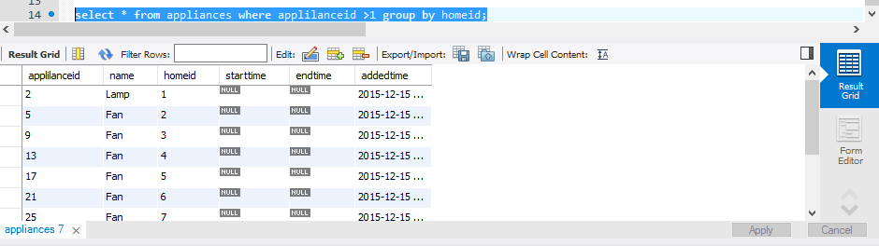
Set 3 - Select – From – Where – Group By – Having - Order By - Limit

Slide 13
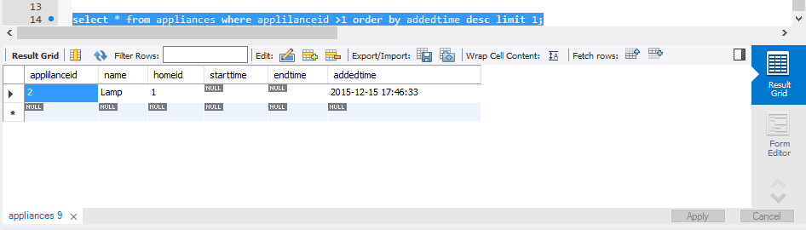
Set 3 - Select – From – Where – Group By – Having - Order By - Limit

Slide 14
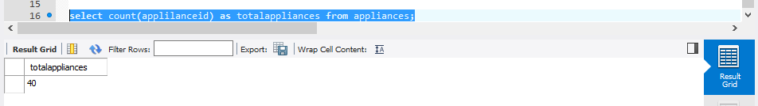
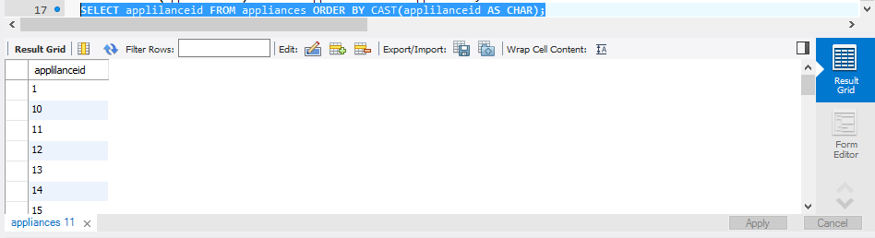
Set 4 – Functions in SQL

Slide 15
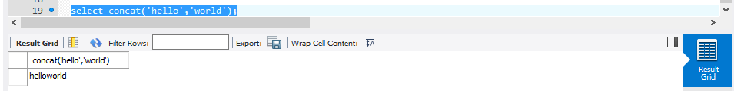
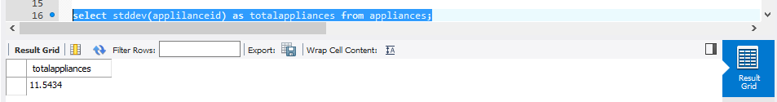
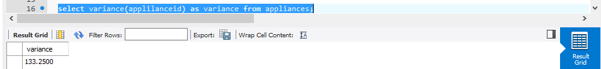
Set 4 – Functions in SQL

Slide 16
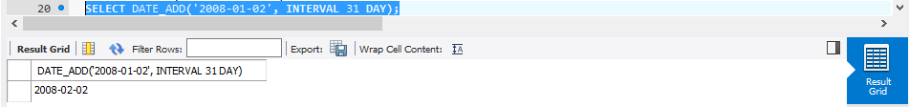
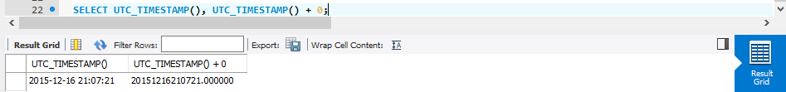
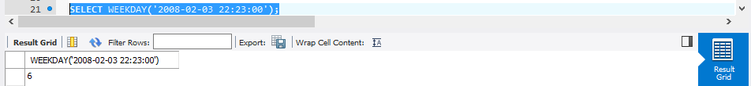
Set 4 – Functions in SQL

Slide 17
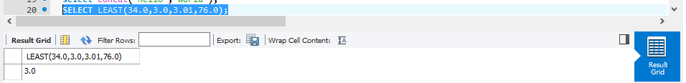
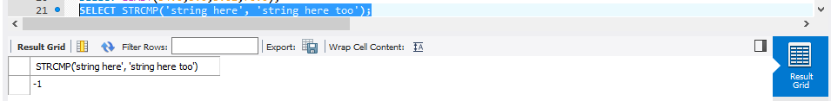
Set 4 – Functions in SQL

Slide 18
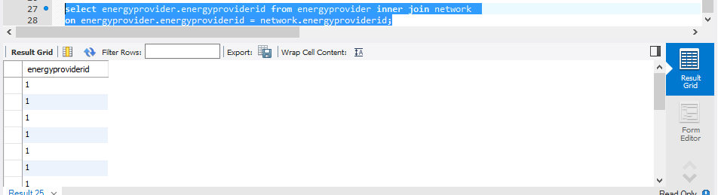
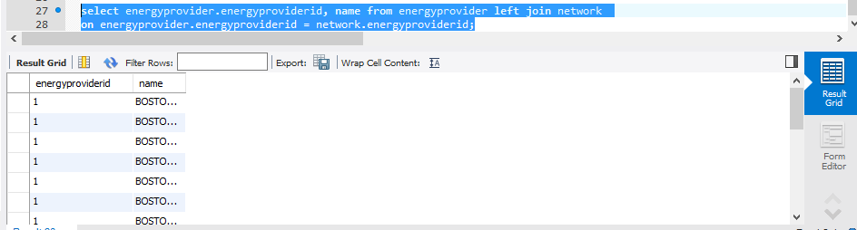
Set 5 – joins

Slide 19
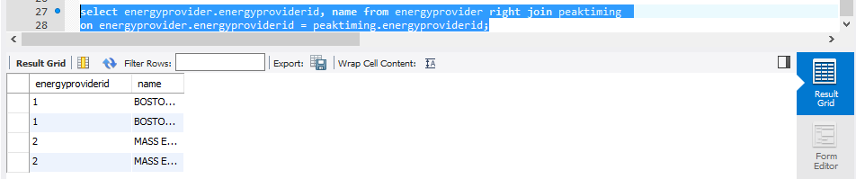
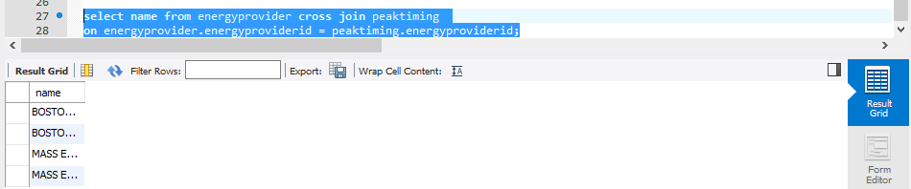
Set 5 – joins

Slide 20
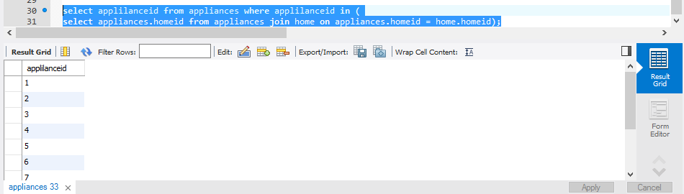
Set 6 – subqueries

Slide 21
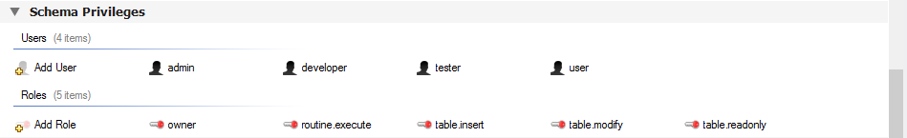
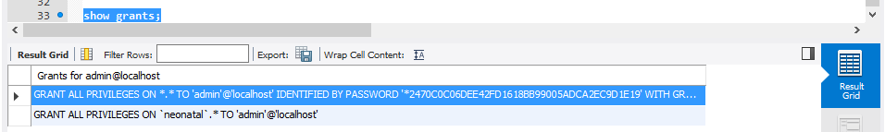
SET 7 – USERS AND PRIVILEGE

Slide 22
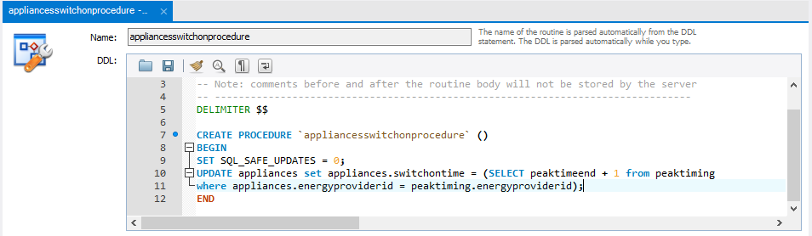
Set 8 – stored procedure
For all the appliances that are working, this stored procedure sets the switch on time for them after the peak time is over.

Slide 23
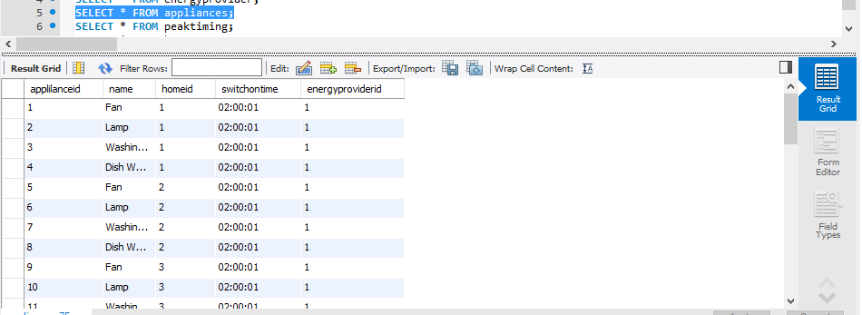
Set 8 – stored procedure

Slide 24
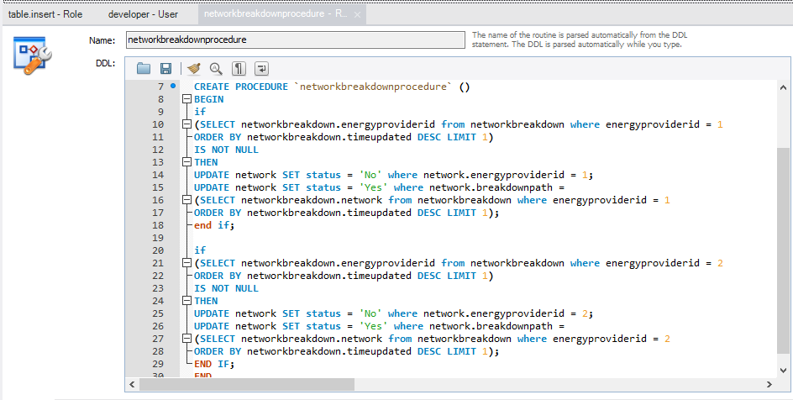
Set 8 – stored procedure

Slide 25
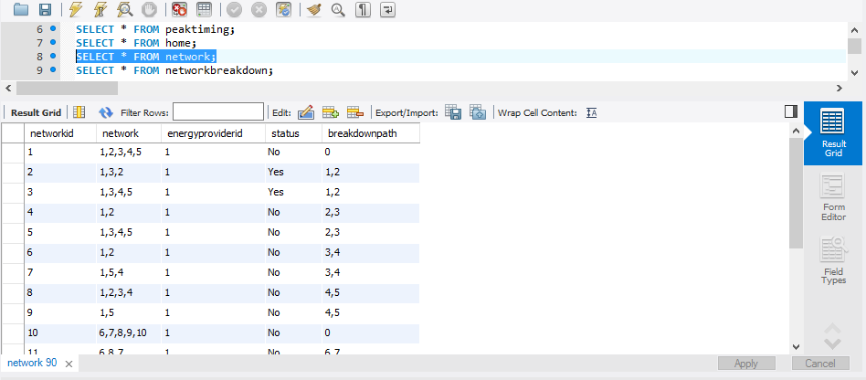
Set 8 – stored procedure

Slide 26
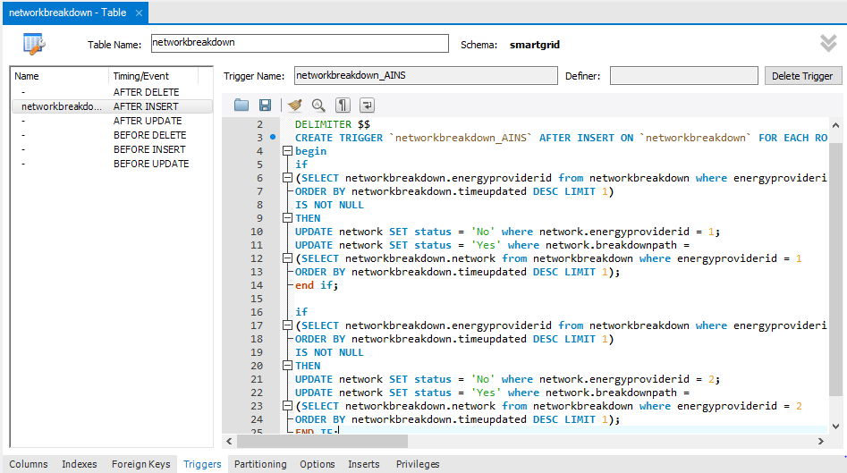
Set 10 – Triggers

Slide 27
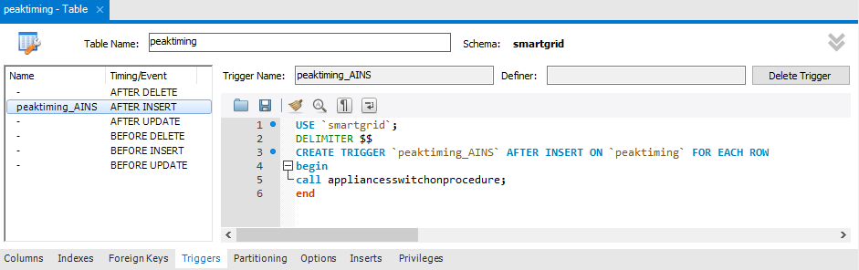
Set 10 – Triggers

Slide 28
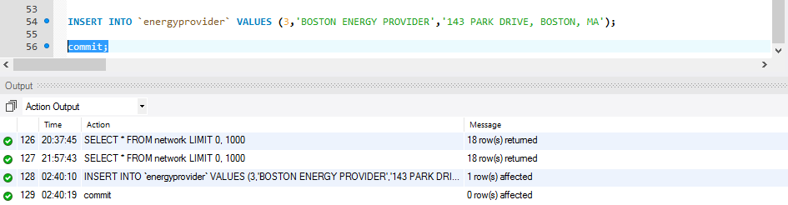
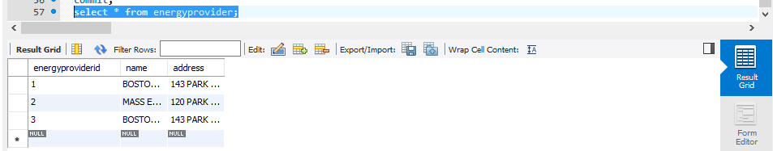
Set 9 – commit

Slide 29
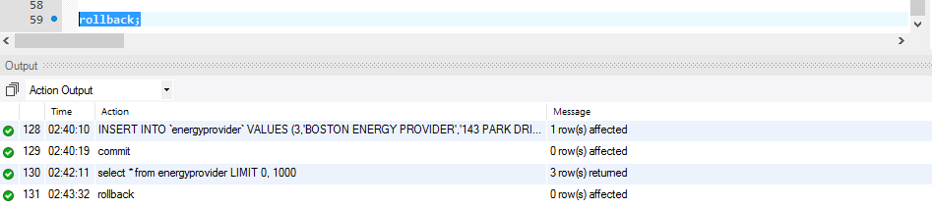
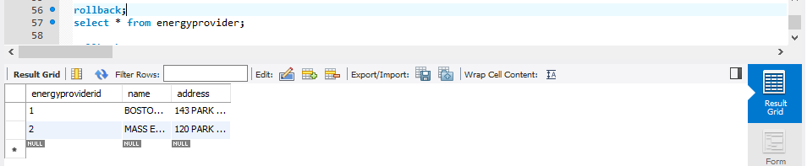
Set 9 – rollback

Slide 30
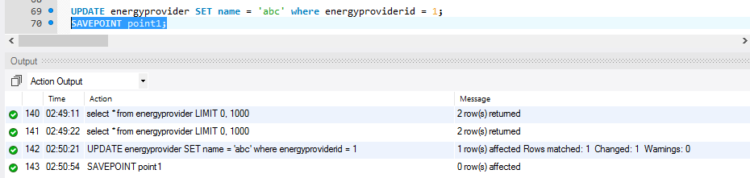
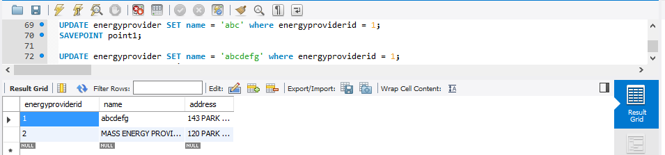
Set 9 – savepoint

Slide 31
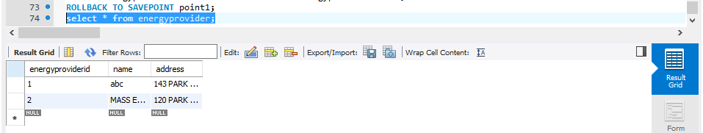
Set 9 – savepoint with rollback

Slide 32
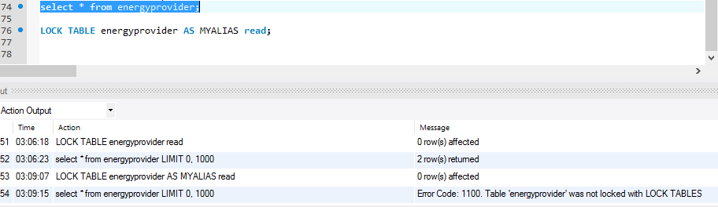
SET 9 – LOCK

Slide 33
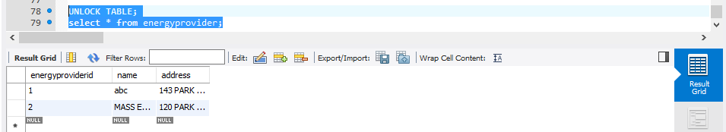
SET 9 – UNLOCK

Slide 34
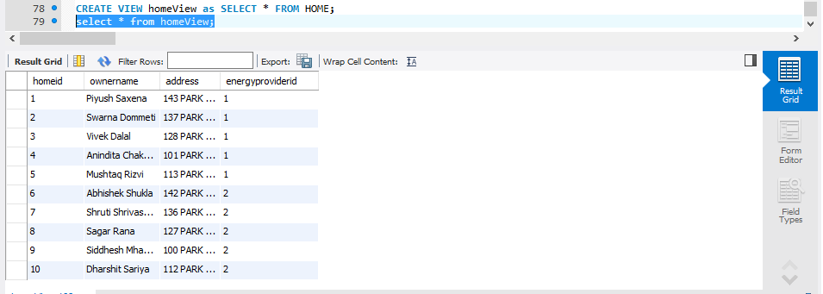
Set 11 – views

Slide 35
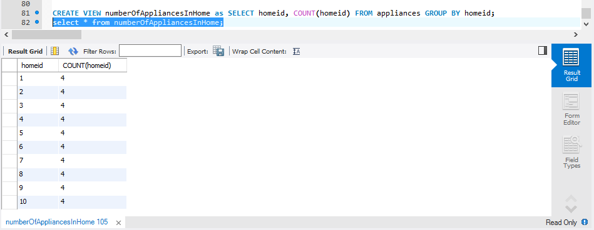
Set 11 – views

Slide 36
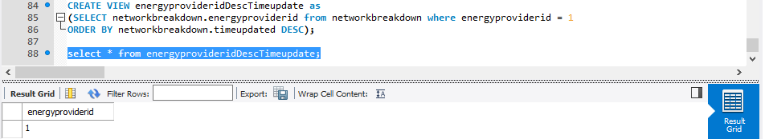
Set 11 – views

Slide 37
Backup plan
As the database is not huge, we can create a backup plan which is a combination of Incremental and Full back up plans.
On every Sunday we can take a full backup.
On weekdays we can take incremental backup.
Now if there is an issue on Thrusday, we can get the data from the full baack up from Sunday and the incremental backup from Monday, Tuesday and Wednesday.

Slide 38
Date | Day | Backup Type | Backup Time
1 | Sunday | Full Backup | 3am
2 | Monday | Incremental Backup | 12am
3 | Tuesday | Incremental Backup | 12am
4 | Wednesday | Incremental Backup | 12am
5 | Thursday | Incremental Backup | 12am
6 | Friday | Incremental Backup | 12am
7 | Saturday | Incremental Backup | 12am
8 | Sunday | Full Backup | 3am
9 | Monday | Incremental Backup | 12am
10 | Tuesday | Incremental Backup | 12am
11 | Wednesday | Incremental Backup | 12am
12 | Thursday | Incremental Backup | 12am
13 | Friday | Incremental Backup | 12am
14 | Saturday | Incremental Backup | 12am

Slide 39
Date | Day | Backup Type | Backup Time
15 | Sunday | Full Backup | 3am
16 | Monday | Incremental Backup | 12am
17 | Tuesday | Incremental Backup | 12am
18 | Wednesday | Incremental Backup | 12am
19 | Thursday | Incremental Backup | 12am
20 | Friday | Incremental Backup | 12am
21 | Saturday | Incremental Backup | 12am
22 | Sunday | Full Backup | 3am
23 | Monday | Incremental Backup | 12am
24 | Tuesday | Incremental Backup | 12am
25 | Wednesday | Incremental Backup | 12am
26 | Thursday | Incremental Backup | 12am
27 | Friday | Incremental Backup | 12am
28 | Saturday | Incremental Backup | 12am
29 | Sunday | Full Backup | 3am
30 | Saturday | Incremental Backup | 12am

Slide 40
references
http://www.ieee-security.org/TC/SP2013/papers/4977a301.pdf
http://security.stackexchange.com/questions/83174/how-can-i-securely-delete-items-in-a-database
https://en.wikipedia.org/
http://dev.mysql.com/
http://www.w3schools.com/

